Slide 1

Windows Management Console (MMC)
Built-in Windows framework for administrative tools
Uses Snap-ins to manage different parts of Windows
Provides a single interface for system administration
Administrators can create custom consoles for specific tasks

Slide 2
What is a Management Console?
Centralized Tool for Administration
Provides a graphical interface to configure and monitor Windows
Helps administrators troubleshoot problems
Allows management of hardware, software, users, services and logs
Common Management Consoles
Device Manager – Hardware and drivers
Disk Management – Disks and partitions
Event Viewer – System logs
Services – Windows services
Task Scheduler – Automated tasks
Performance Monitor – Performance analysis
Computer Management – Collection of administrative tools

Slide 3

Computer Management
Computer Management (compmgmt.msc)
Centralized console containing multiple administration tools
Main Sections
  System Tools
  Storage
  Services and Applications

Slide 4
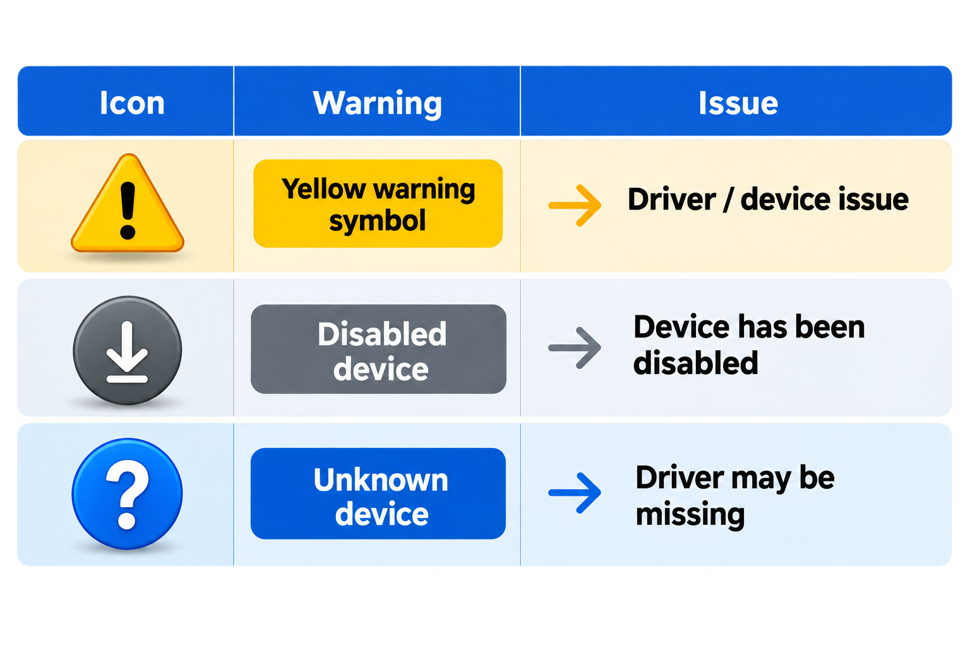
Device Manager
View hardware
Install or update drivers
Disable devices
Uninstall devices
Identify hardware problems

Slide 5
Event Viewer
Records system and application events
Important Logs
  Application
  System
  Security
Application Crashes
Driver Failures
Service Failures
Security events
Boot Problems
Unexpected Shutdowns
Troubleshooting OR Investigating

Slide 6
Services Console
Windows Services (services.msc)
Services are background programs that perform specific functions
  Start a service
  Stop a service
  Restart a service
  Configure startup type
Startup Types
  Automatic
  Automatic (Delayed Start)
  Manual
  Disabled

Slide 7
Task Scheduler
Task Scheduler (taskschd.msc)
Automatically executes tasks based on specific conditions
  Tasks can run at startup
  Tasks can run at login
  Tasks can run at a specific time
  Tasks can run when an event occurs
Use cases
  Automatic backups
  Maintenance scripts
  Log cleanup
  System monitoring

Slide 8

Performance Monitor and Resource Monitor
Monitor System Performance
  CPU usage
  Memory usage
  Disk activity
  Network performance

Slide 9
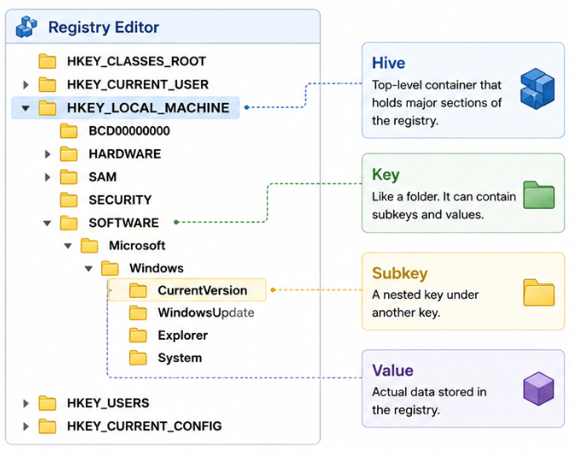
Registry Editor (regedit.exe)
Topic | Content
🗂️ Windows Registry | Central hierarchical database containing Windows and application configuration
🛠️ Registry Editor | GUI tool used to manage registry settings
🌳 Registry Structure | Hives → Keys → Subkeys → Values
⚙️ Configuration | Controls system, user, hardware, services, and application settings
🔍 Troubleshooting | Used to diagnose and modify advanced Windows configurations
⚠️ Risk | Incorrect changes can cause application or Windows problems

Slide 10
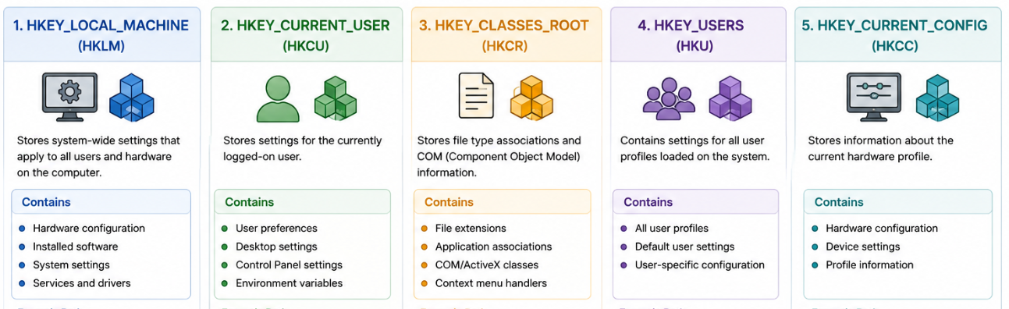

Slide 11
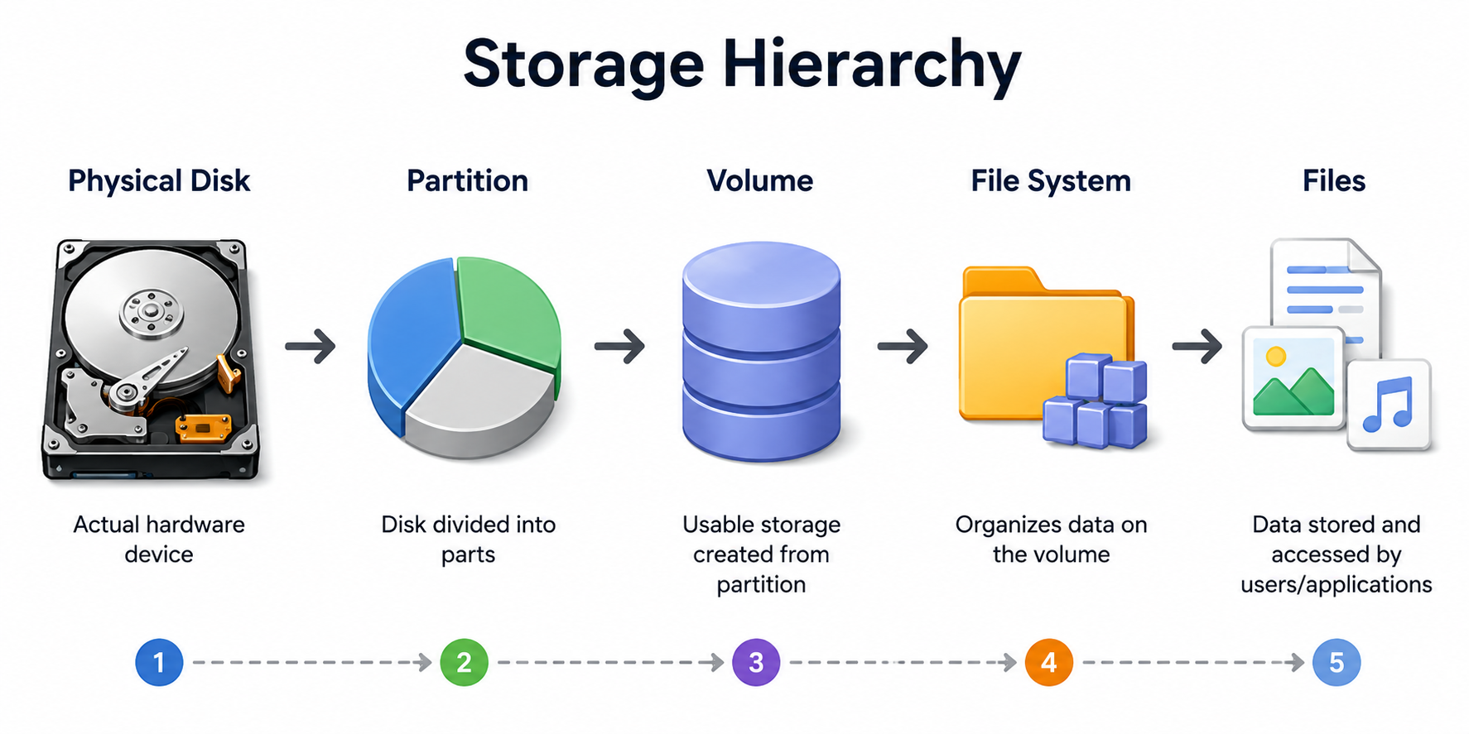
Disk Management
Used to manage physical disks and logical storage
  Initialize disk
  Create partition
  Format volume
  Assign drive letter
  Extend volume
  Shrink volume
  Change drive letter

Slide 12
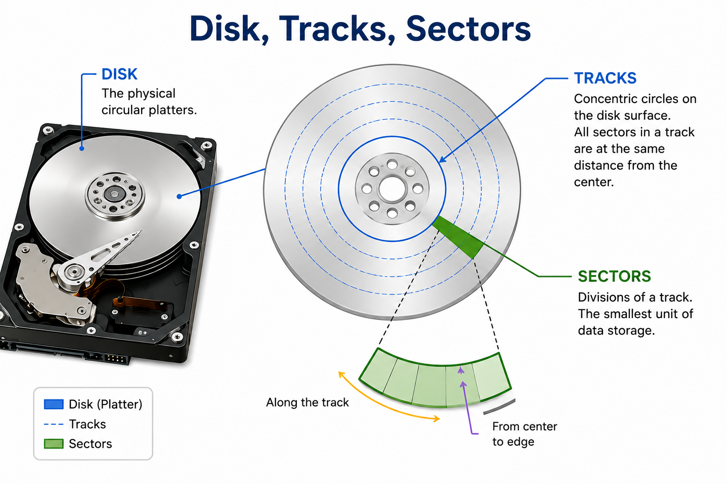
Understanding Sectors
Sector = Smallest Addressable Storage Unit on a Disk
A disk is divided into many sectors
Traditional HDD: common sector size is 512 bytes
Modern drives: common physical sector size is 4 KB
Disk organization: Disk → Tracks → Sectors

Slide 13
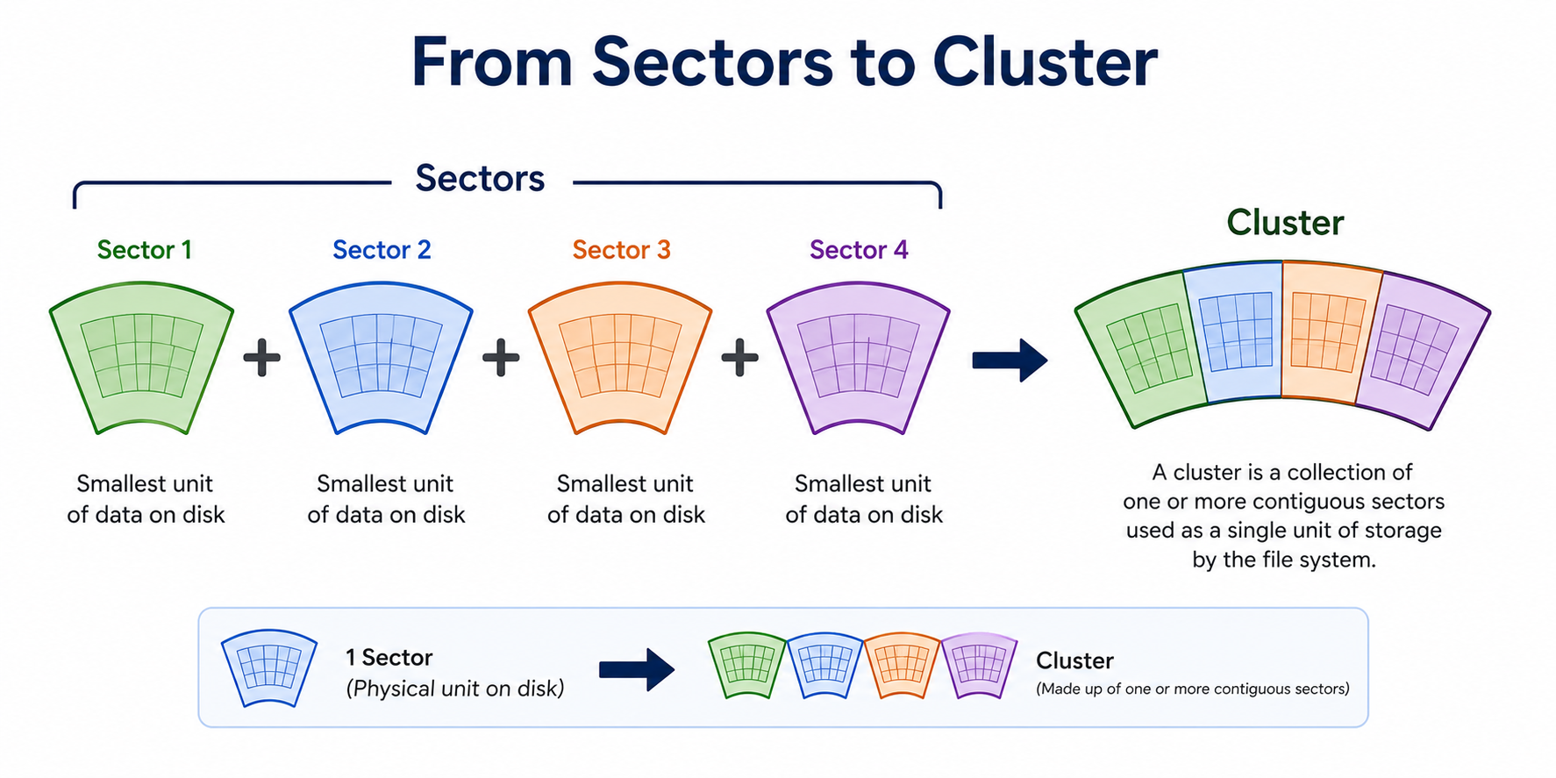
Understanding Clusters
Cluster = Smallest Unit Allocated by a File System
A cluster consists of one or more sectors
The file system allocates clusters to store files
Sector → Physical storage organization
Cluster → File-system allocation unit
Why clusters matter
Storage efficiency
File allocation
Disk space usage

Slide 14
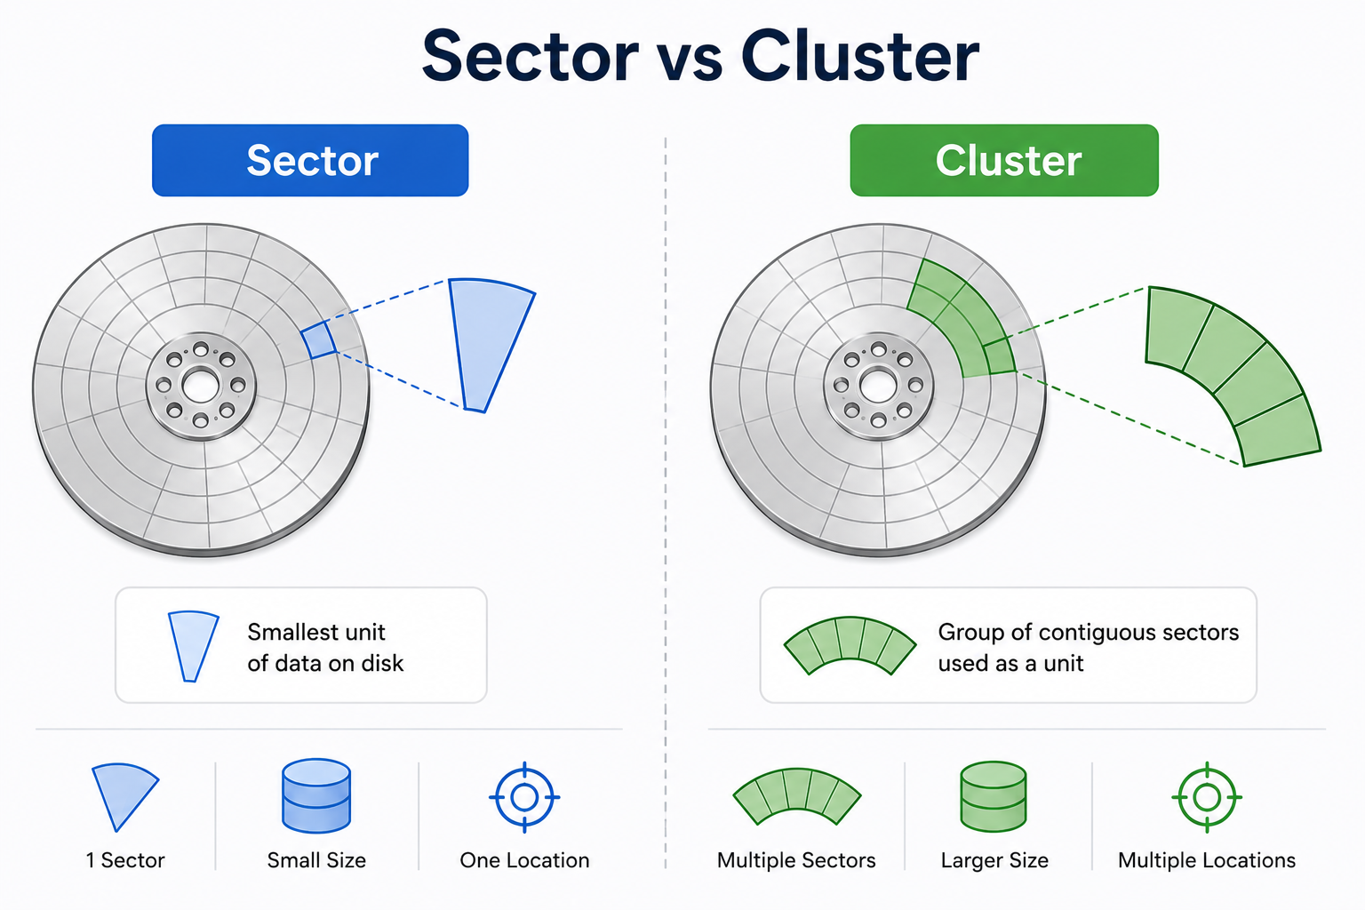
Sector vs Cluster

Slide 15
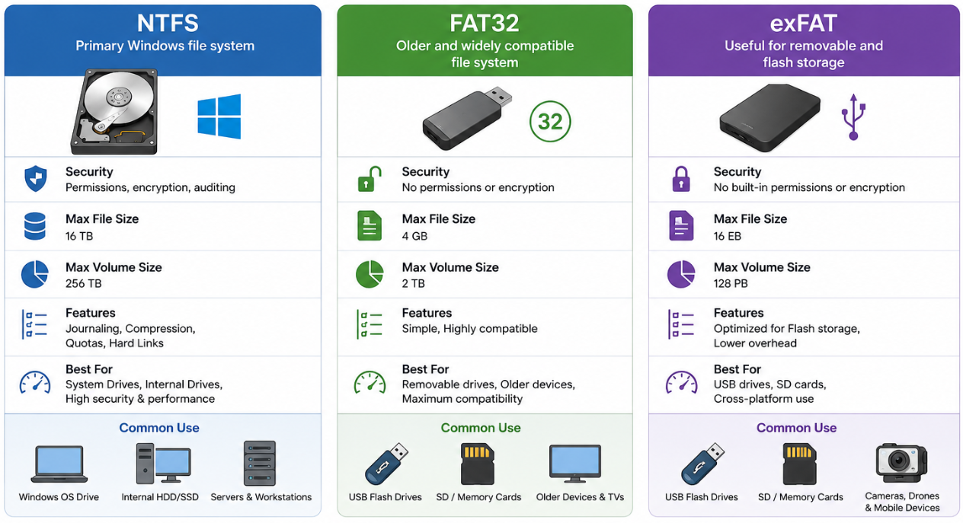
File Systems
File System = Rules for Organizing Data
File system manages files, folders, permissions, and metadata
File system manages storage allocation
Storage flow: Disk → Partition → File System → Folders → Files

Slide 16
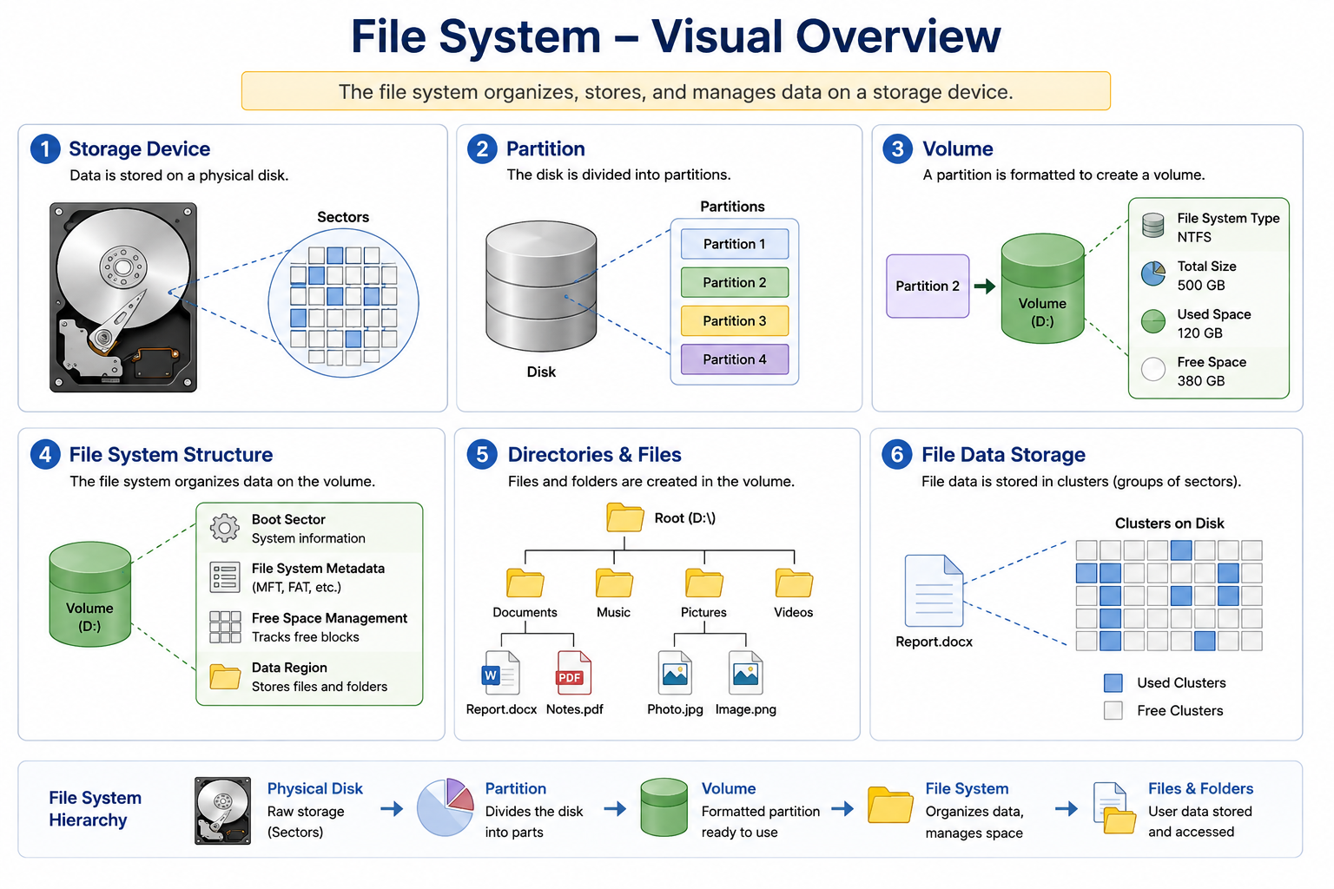

Slide 17

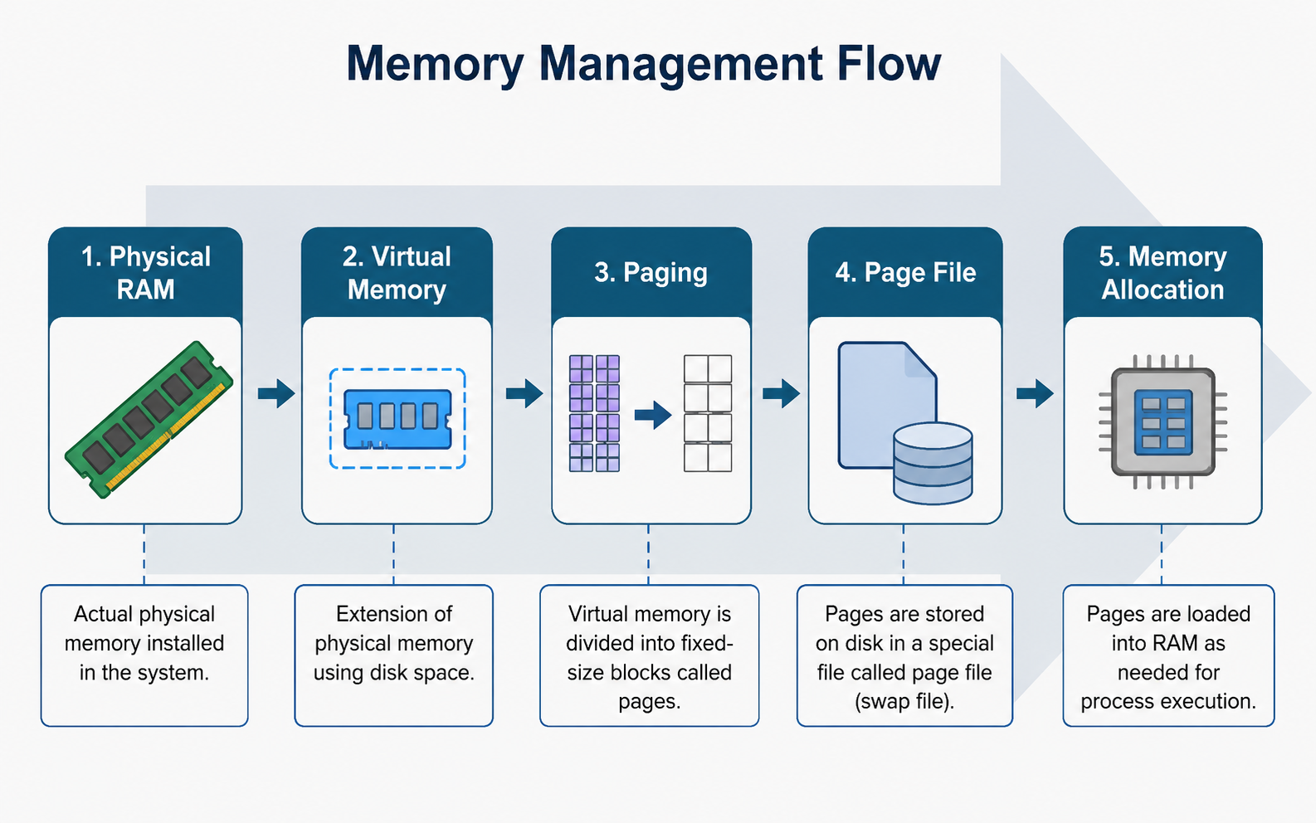
Memory Management
Windows manages memory between applications and the operating system
When RAM becomes limited, Windows can use a page file on storage
Key point: RAM is fast; storage is slower
Excessive paging can reduce performance

Slide 18
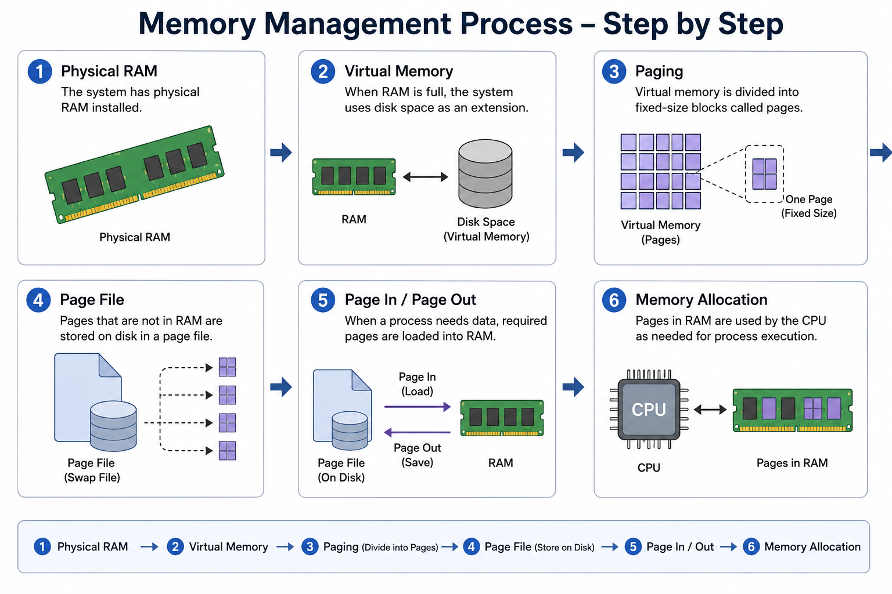

Slide 19
Memory Management Tools
Task Manager
  Applications using RAM
  Available memory
  Resource Monitor
  Detailed memory usage
  Processes
Windows Memory Diagnostic
Performance Monitor

Slide 20
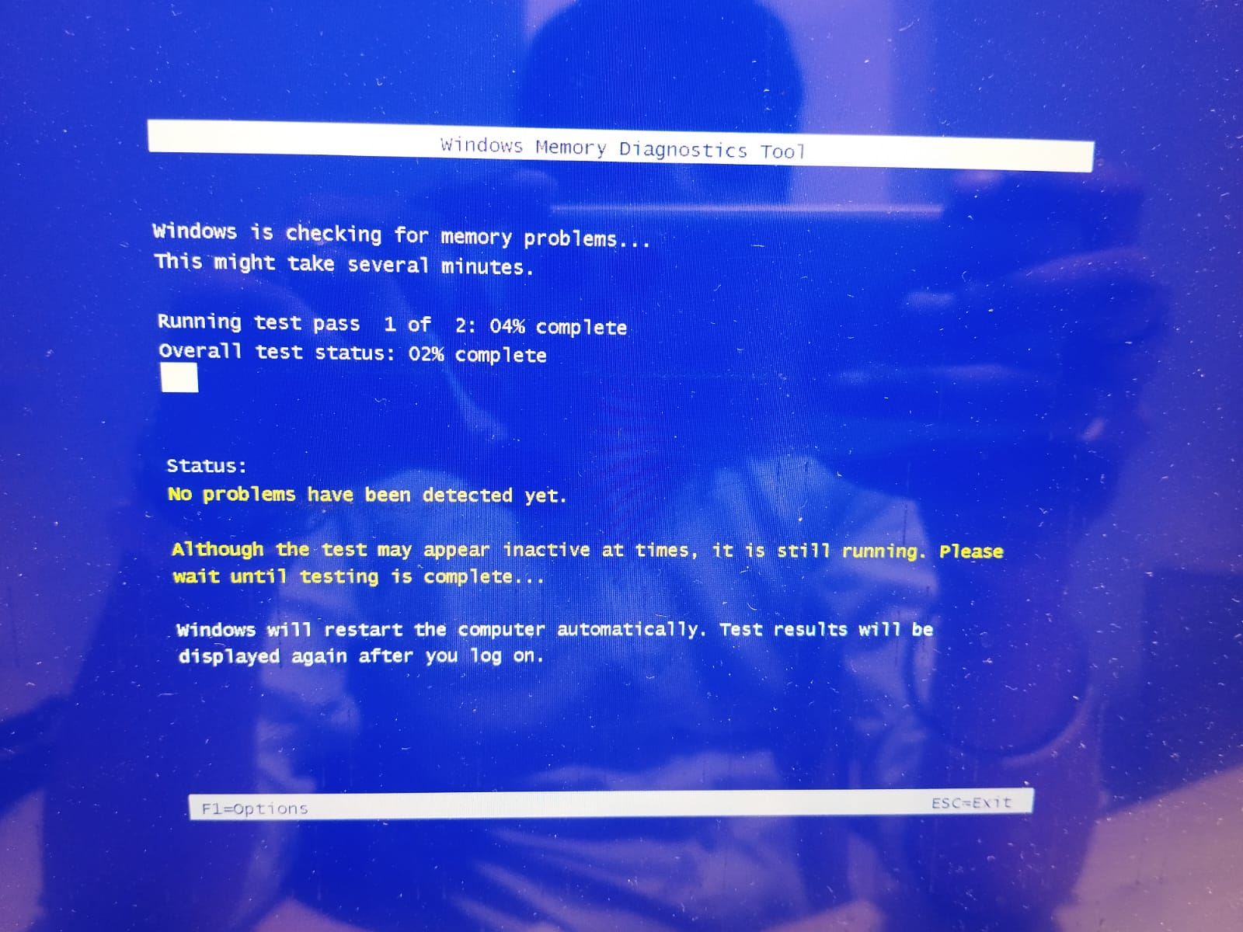

Slide 21
Hardware Troubleshooting Method
Follow a Systematic Approach
  Identify the problem
  Gather information
  Check physical connections
  Check power
  Check POST and boot behavior
  Check Device Manager
  Check Event Viewer
  Test individual components
  Apply the fix
  Verify the solution

Slide 22

Common PC Hardware Problems
Power Problems
No power
Random shutdown
PSU issues
Loose connections
POST Problems
Beep codes
No display during startup
RAM, CPU, or motherboard issues
Display Problems
No signal
Wrong input
Cable failure
GPU or driver problem
Overheating
High temperature
Fan failure
Dust buildup
Poor airflow
Thermal paste issues

Slide 23
Troubleshooting Using Management Consoles
Connect Hardware Symptoms with Windows Tools
Hardware not detected → Device Manager
Driver failure → Device Manager + Event Viewer
Application crash → Event Viewer
Service not working → Services + Event Viewer
High RAM usage → Task Manager + Resource Monitor
Disk problem → Disk Management + Event Viewer
Slow system → Task Manager + Performance Monitor
Scheduled task failure → Task Scheduler + Event Viewer

Slide 24
Complete Troubleshooting Flow
Physical Hardware
Power and Cables
POST / BIOS / UEFI
Windows Boot
Device Manager
Event Viewer
Services and Tasks
Performance Monitoring
Identify Root Cause
Fix and Verify

Slide 25
Quick Recap
MMC provides a framework for administrative snap-ins
Management Consoles help configure and troubleshoot Windows
Device Manager → Hardware and drivers
Event Viewer → Logs and events
Services → Background services
Disk Management → Disks and volumes
Sectors → Physical storage units
Clusters → File-system allocation units
Memory Management → RAM and virtual memory
Performance Tools → Identify resource bottlenecks
Systematic Troubleshooting → Find the root cause efficiently
Final concept: Understand the hardware → Understand Windows → Use the right management console → Troubleshoot systematically

